Slide 1
Digital Portfolio
STUDENT NAME: K.Sabrin nisha
REGISTER NO AND NMID: 222401261 and
asunm11024ai151
DEPARTMENT: Bsc Computer science with Artificial intelligence
COLLEGE: COLLEGE/ UNIVERSITY DRBCCC
hindu college and Madras University

Slide 2
PROJECT TITLE
Student Digital Portfolio

Slide 3

AGENDA
Problem Statement
Project Overview
End Users
Tools and Technologies
Portfolio design and Layout
Features and Functionality
Results and Screenshots
Conclusion
Github Link
3/21/2024 Annual Review

Slide 4

PROBLEM STATEMENT
This project is a Student Portfolio Website using HTML, CSS, and JavaScript. HTML builds the structure with profile, about, skills, projects, and contact sections. CSS provides styling and layout to make the site attractive.
JavaScript adds form validation and interactivity. The website helps students showcase their details and skills effectively

Slide 5

PROJECT OVERVIEW
The Student Portfolio Website is built using HTML, CSS, and JavaScript to showcase a student’s profile, skills, projects, and contact details. HTML provides the structure, CSS makes the design attractive, and JavaScript adds interactivity through form validation. The project helps students present their details in a professional and user-friendly way. It acts as a digital portfolio or online resume for academic and career purpose

Slide 6

WHO ARE THE END USERS:
The end users of this project are students who want to showcase their personal details, skills, and projects, and recruiters/teachers who view the portfolio for academic evaluation, internships, or job opportunities

Slide 7

TOOLS AND TECHNIQUES
The project is developed using HTML for webpage structure, CSS for styling and layout, and JavaScript for form validation and interactivity. A text editor such as VS Code / Notepad++ is used for coding, and a web browser (Chrome, Edge, or Firefox) is used for testing and executions

Slide 8
POTFOLIO DESIGN AND LAYOUT
Presentation Layer (Front-End): Created using HTML to define structure (profile, about, skills, projects, contact) and CSS to style the layout, colors, and fonts.
2. Logic Layer (Interactivity): Implemented with JavaScript to handle user interactions such as contact form validation and dynamic messages.

Slide 9
FEATURES AND FUNCTIONALITY
1 Displays student’s photo, name, and academic details.
2. About Section – Provides a short introduction about the student.
3. Skills Section – Lists technical and personal skills in an organized way.
4. Projects Section – Highlights student’s academic or personal projects.

Slide 10
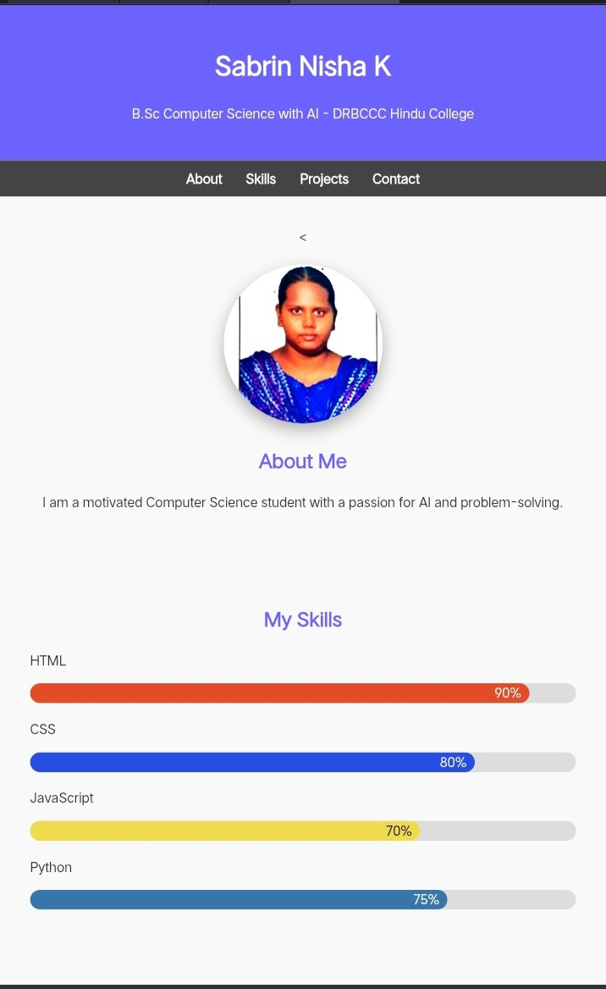
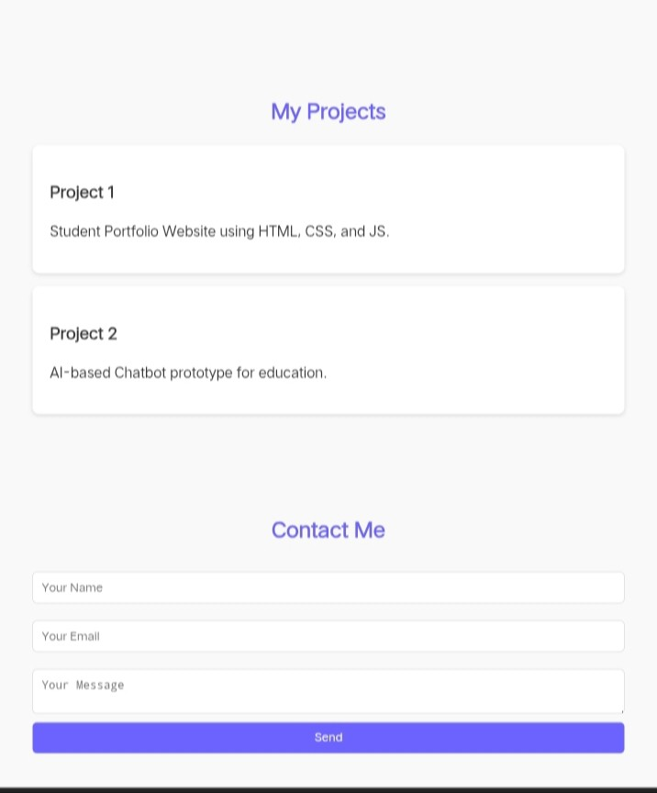

RESULTS AND SCREENSHOTS
3/21/2024 Annual Review

Slide 11
CONCLUSION
The Student Portfolio Website
successfully demonstrates the use of HTML,
CSS, and JavaScript to create a structured, styled, and interactive web application. It allows
students to present their personal details, skills, and projects in a professional
manner. The project proves to be user-friendly, responsive, and effective as a digital portfolio or online resume for academic

